Slide 1


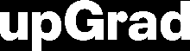

Course : Machine Learning
Lecture On : Intro to TensorFlow + Playground
Instructor : Siddhesh Gunjal
EEdiditt MMaaststeerr tteexxtt ststyleyless
16-05-2021
2

Slide 2
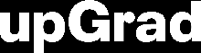


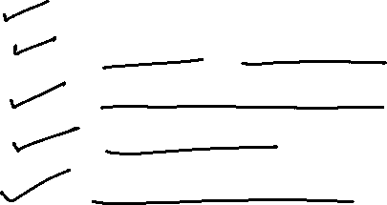
Session - Agenda
Introduction, Industry Use-cases
Weight & activation function
TensorFlow Basics
Playground
Code Showcase
13-02-2021
3

Slide 3
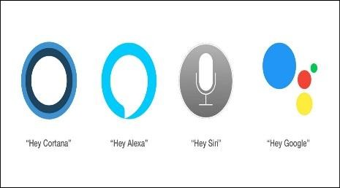





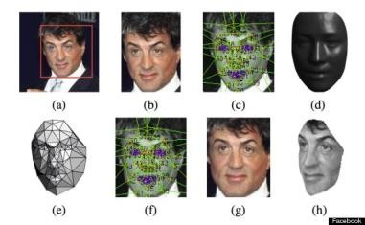



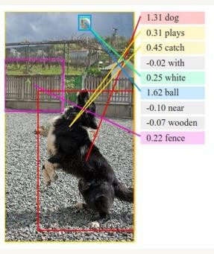
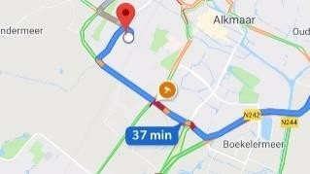




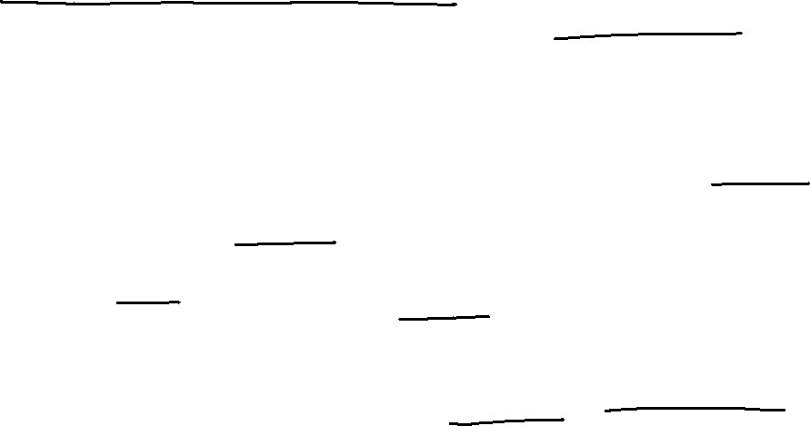
Neural Networks in Business
Voice Assistants
Recommendation Engines
The Terminator
Google
Search
Translate
maps
Facial Recognition
Self-driving cars
Image
Understanding
Email filtering
Customer Support Queries (and Chatbots)
https://www.analyticsvidhya.com/blog/2018/05/24-ultimate-data-science-projects-to-boost- your-knowledge-and-skills/
Catching Fraud in Banking
Video Surveillance
6

Slide 4
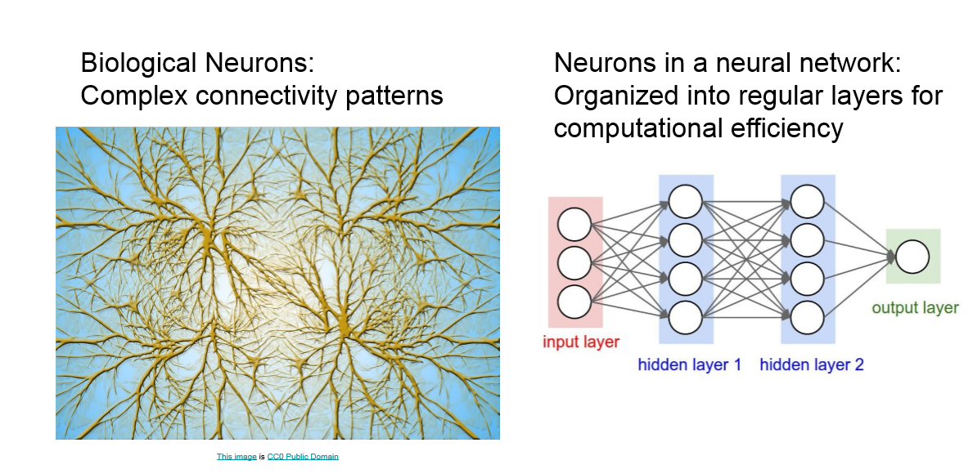
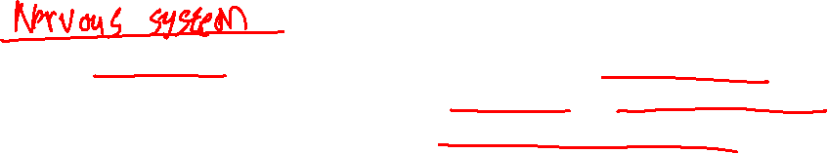

Slide 5
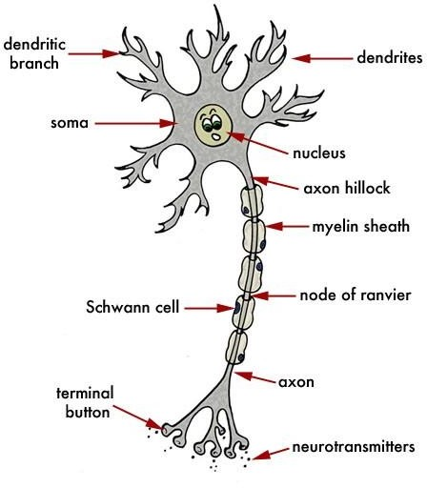
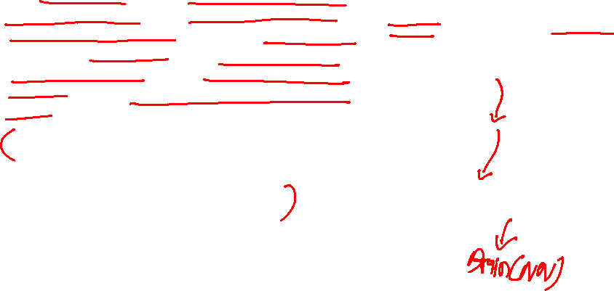
Intuition behind the Perceptron
The human brain consists of neurons or nerve cells which transmit and process the information received from our senses. Many such nerve cells are arranged together in our brain to form a network of nerves. These nerves pass electrical impulses i.e the excitation from one neuron to the other.
The dendrites receive the impulse from the terminal button. Dendrites carry the impulse to the nucleus Here , the electrical impulse is processed and then passed on to the axon
7

Slide 6
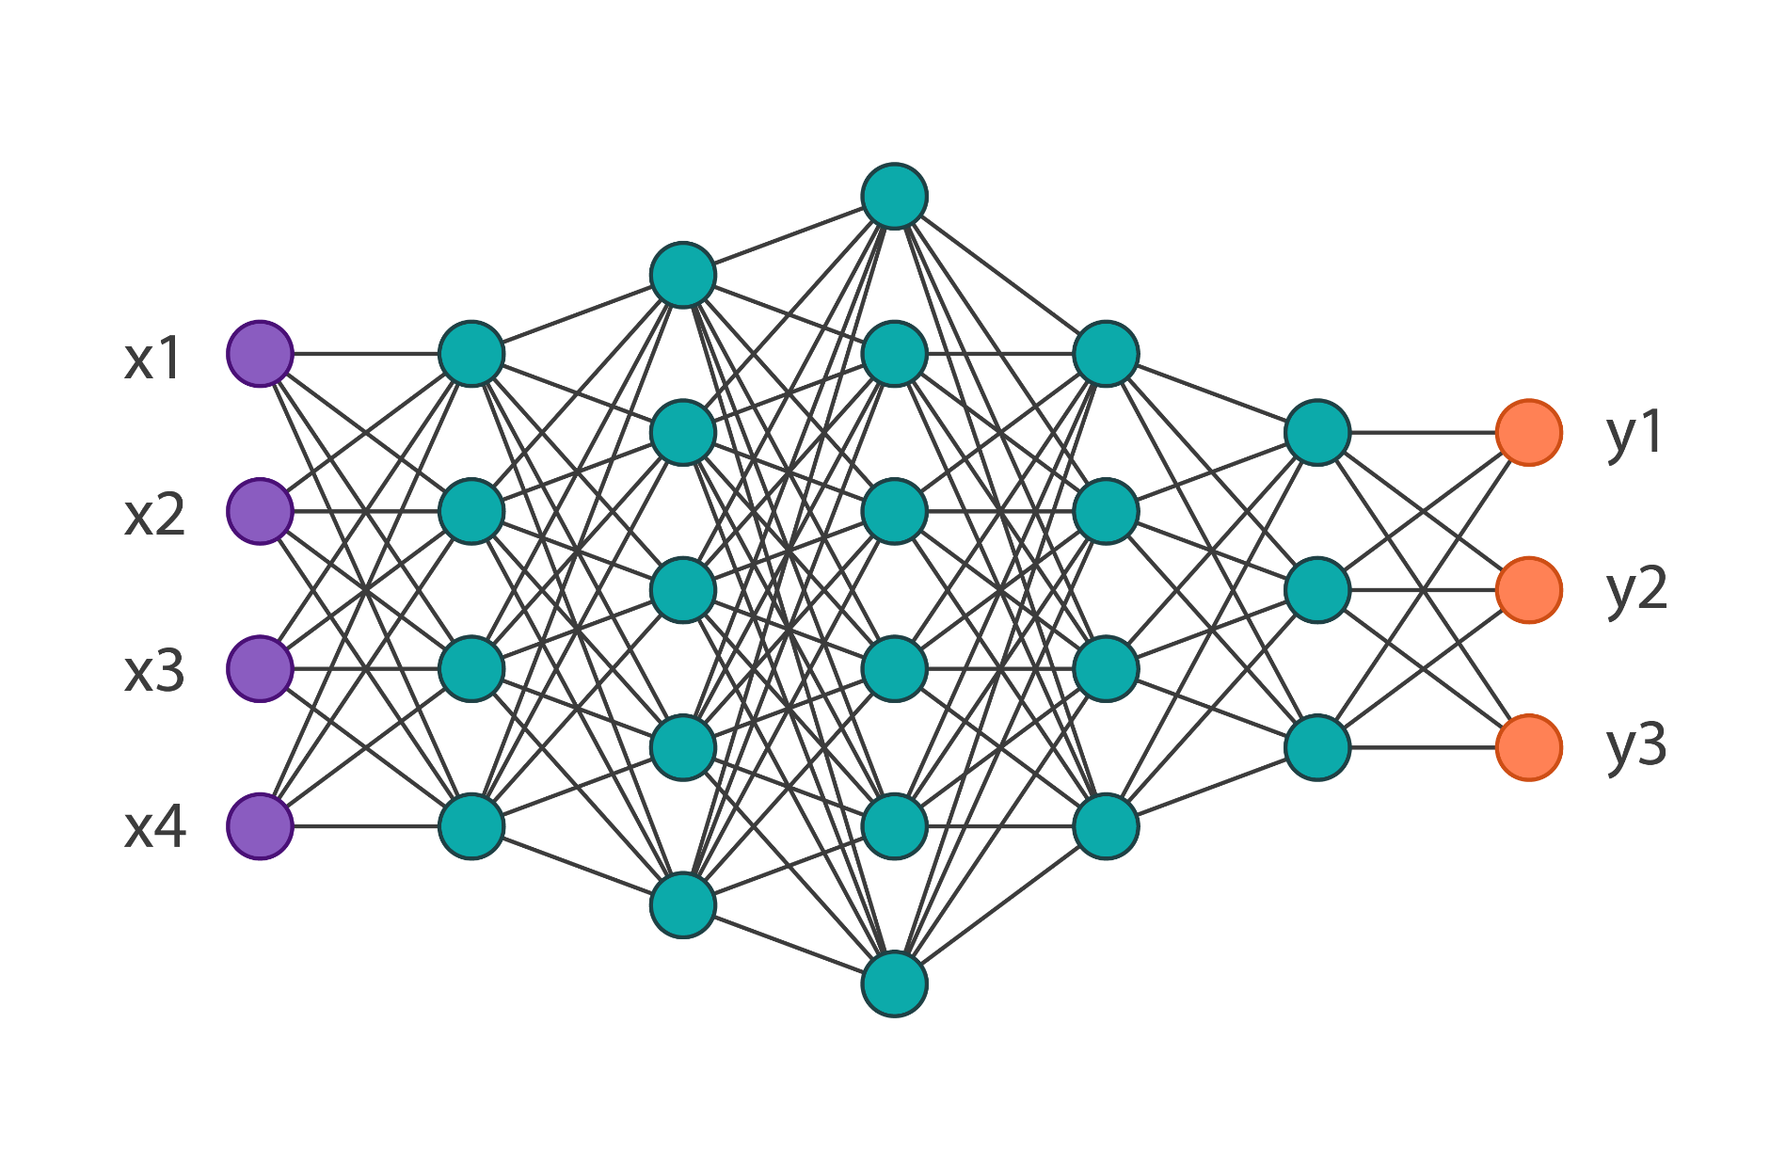
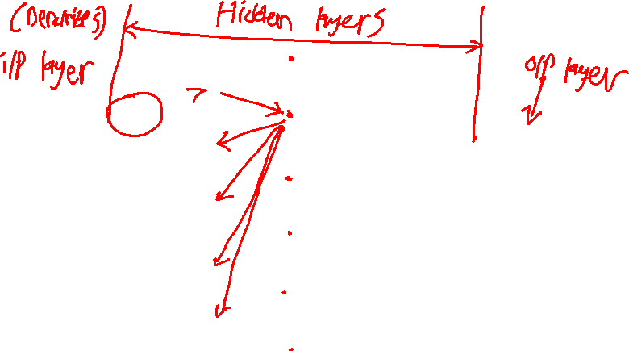
This is how typical NN looks like…

Slide 7
Why Deep Learning?

Slide 8
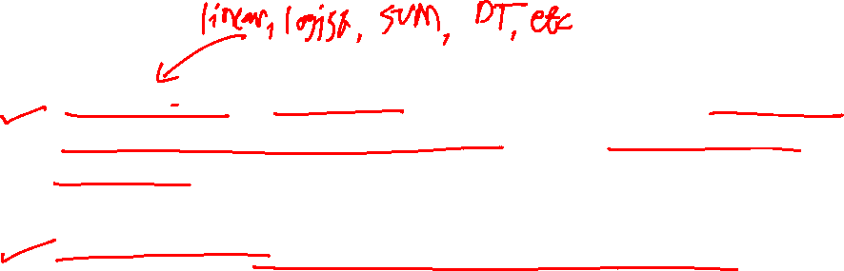
Shallow ML vs Deep Learning
Shallow ML: Learns greedily (in successive manner). Stacking multiple shallow learners together will not achieve the same results.
Deep Learning: The layers learn the patterns jointly

Slide 9
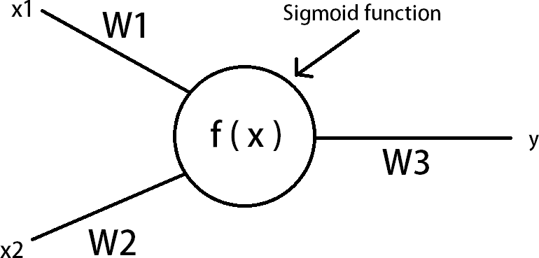
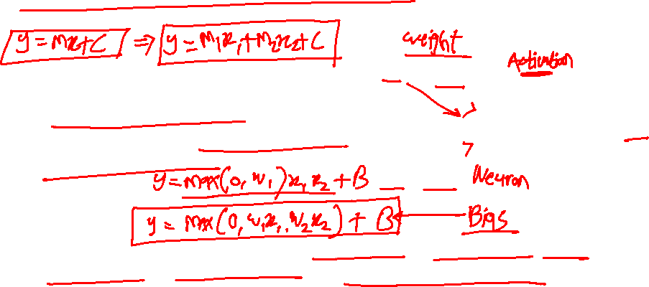
Construction of an Artificial Neuron
In this case , the neurons are created artificially on a computer . Connecting many such artificial neurons creates an artificial neural network.
The data in the network flows through each neuron by a connection. Every connection has a specific weight by which the flow of data is regulated.
8

Slide 10
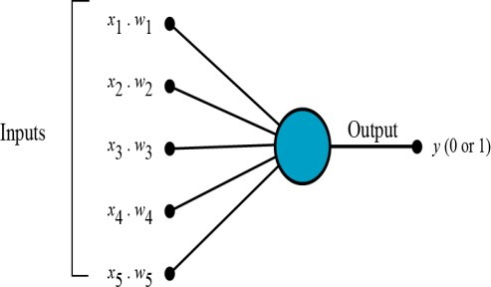
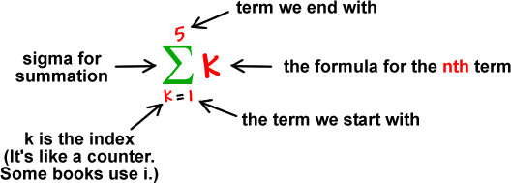
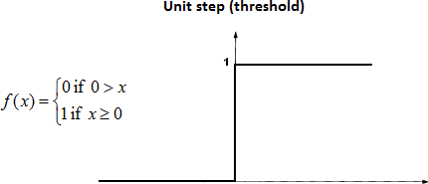
But how does it work?
The perceptron works on these simple steps
All the inputs x are multiplied with their weights w. Let’s call it k.
Add all the multiplied values and call them Weighted Sum
Apply that weighted sum to the correct Activation Function.

Slide 11
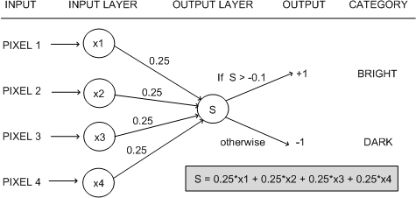
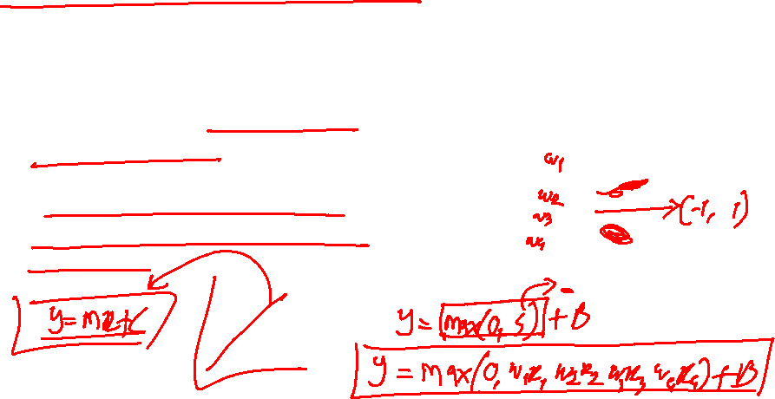
Why do we need Weights and Bias?
Weights shows the strength of
the particular node.
A bias value allows you to shift the activation function curve up or down.

Slide 12




Poll 2
Statement 1: It is possible to train a network well by initializing all the weights as 0
Statement 2: It is possible to train a network well by initializing biases as 0
Which of the statements given above is true?
Statement 1 is true while Statement 2 is false
Statement 2 is true while statement 1 is false
Both statements are true
Both statements are false
Practice in teams of 4 students
Industry expert mentoring to learn better
Get personalised feedback for improvements
13-02-2021
Footer
11
19

Slide 13
Poll 2
Statement 1: It is possible to train a network well by initializing all the weights as 0
Statement 2: It is possible to train a network well by initializing biases as 0
Which of the statements given above is true?
Statement 1 is true while Statement 2 is false
Statement 2 is true while statement 1 is false
Both statements are true
Both statements are false
Even if all the biases are zero, there is a chance that neural network may learn. On the other hand, if all the weights are zero; the neural neural network may never learn to perform the task.
Get personalised feedback for improvements
13-02-2021
Footer
11
20

Slide 14

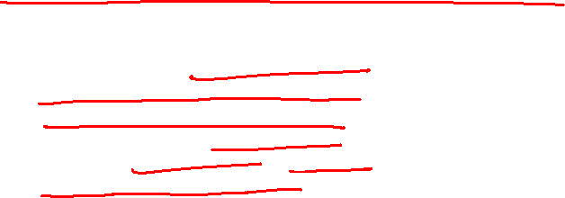
why can’t we do it without activating the input signal
A linear equation is easy to solve but they are limited in their complexity and have less power to learn complex functional mappings from data. A Neural Network without Activation function would simply be a Linear regression Model, which has limited power and does not performs good most of the times.
That is why we use Artificial Neural network techniques such as Deep learning to make sense of something complicated ,high dimensional, non-linear -big datasets, where the model has lots and lots of hidden layers in between and has a very complicated architecture which helps us to make sense and extract knowledge form such complicated big datasets.
https://towardsdatascience.com/activation-functions-neural-networks-1cbd9f8d91d6

Slide 15
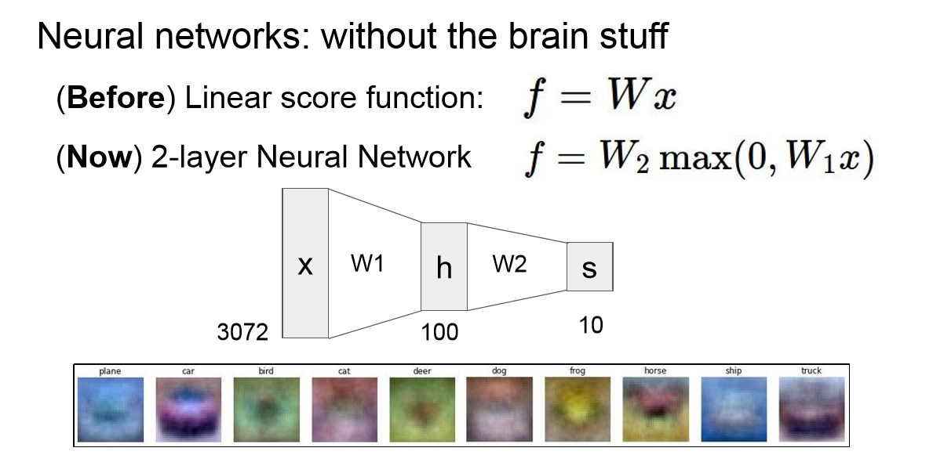
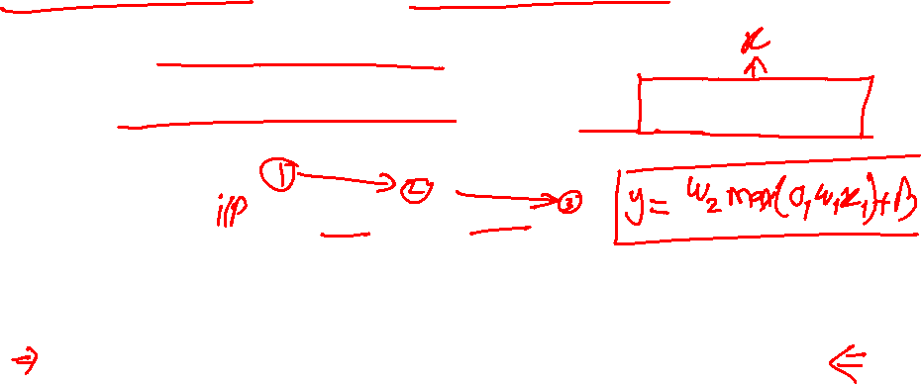
Why we use Activation functions

Slide 16
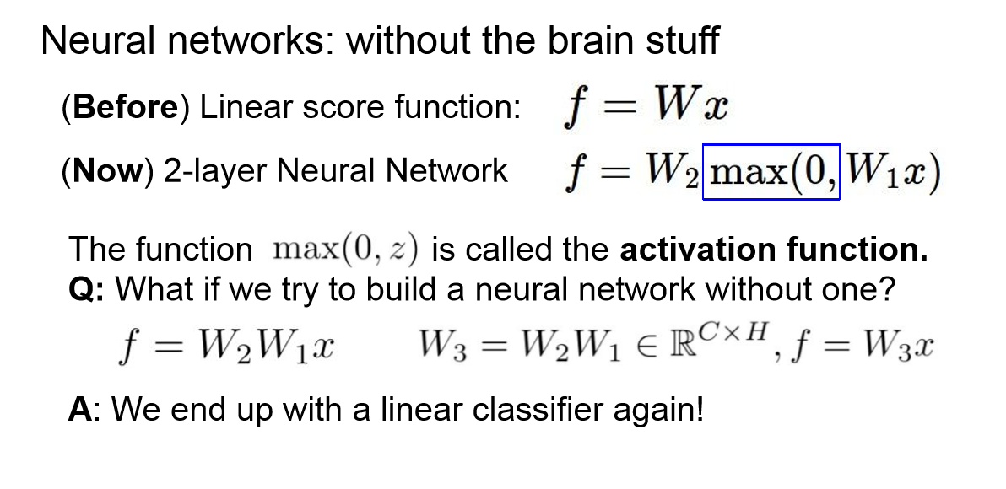
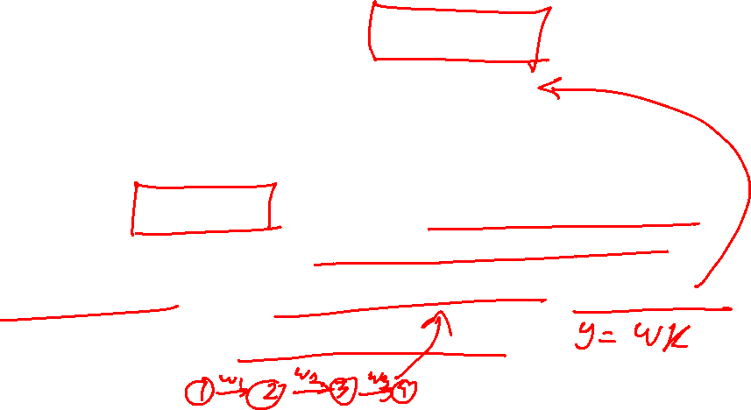
Why we use Activation functions

Slide 17
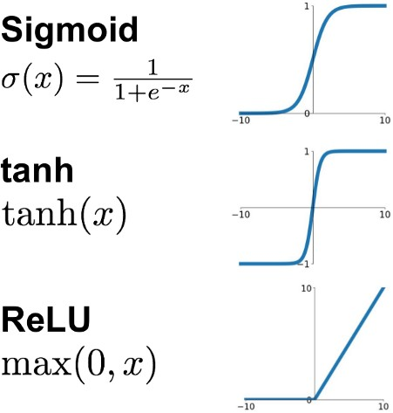
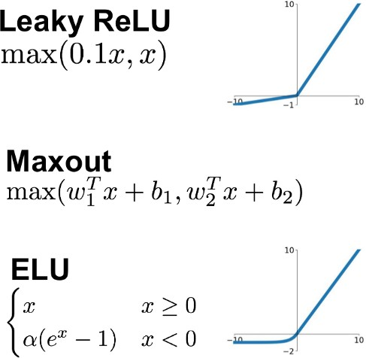
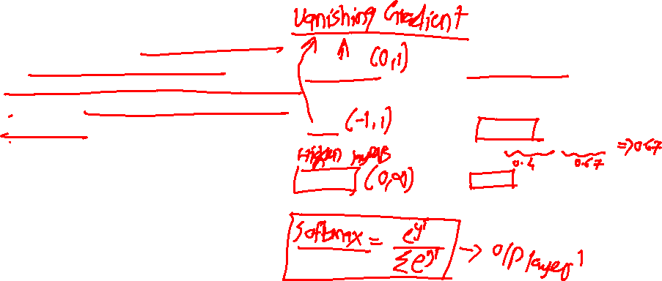
Why we use Activation functions
Activation functions are really important for a Artificial Neural Network to learn and make sense Non-linear complex functional mappings between the inputs and response variable.
They introduce non-linear properties to our Network. Their main purpose is to convert a input signal of a node in a A-NN to an output signal. That output signal now is used as a input in the next layer in the stack.
https://ai.stackexchange.com/questions/5493/what-is-the-purpose-of-an-activation-function-in-neural-networks

Slide 18
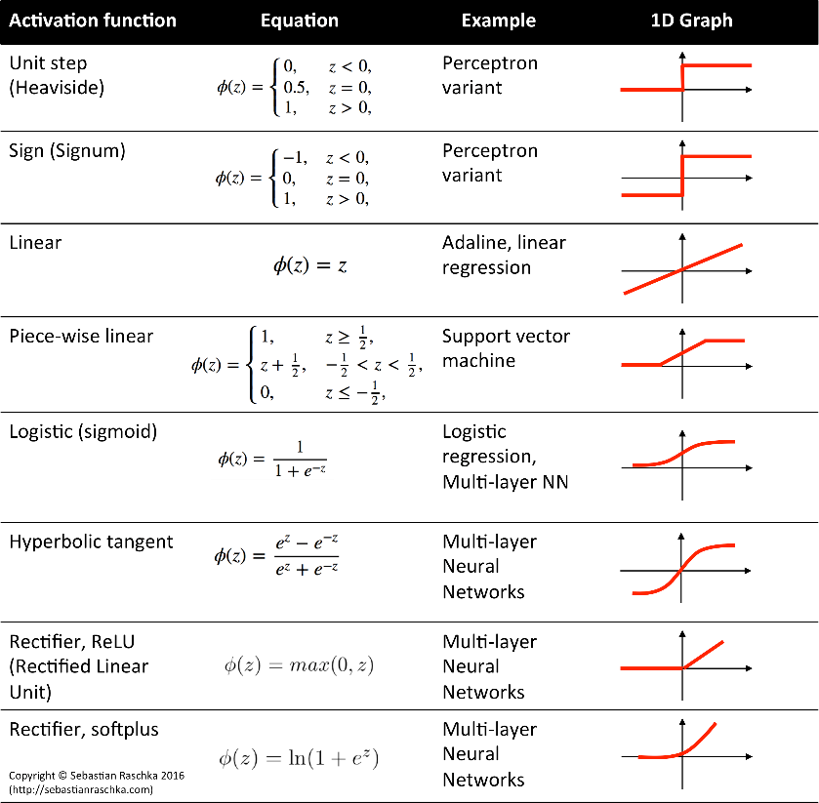

which one is better to use ?
Nowadays we should use ReLu which should only be applied to the hidden layers. And if your model suffers form dead neurons during training we should
use leaky ReLu or Maxout function.
It’s just that Sigmoid and Tanh should not be used nowadays due to the vanishing Gradient Problem which causes a lots of problems to train,degrades the accuracy and performance of a deep Neural Network Model.

Slide 19
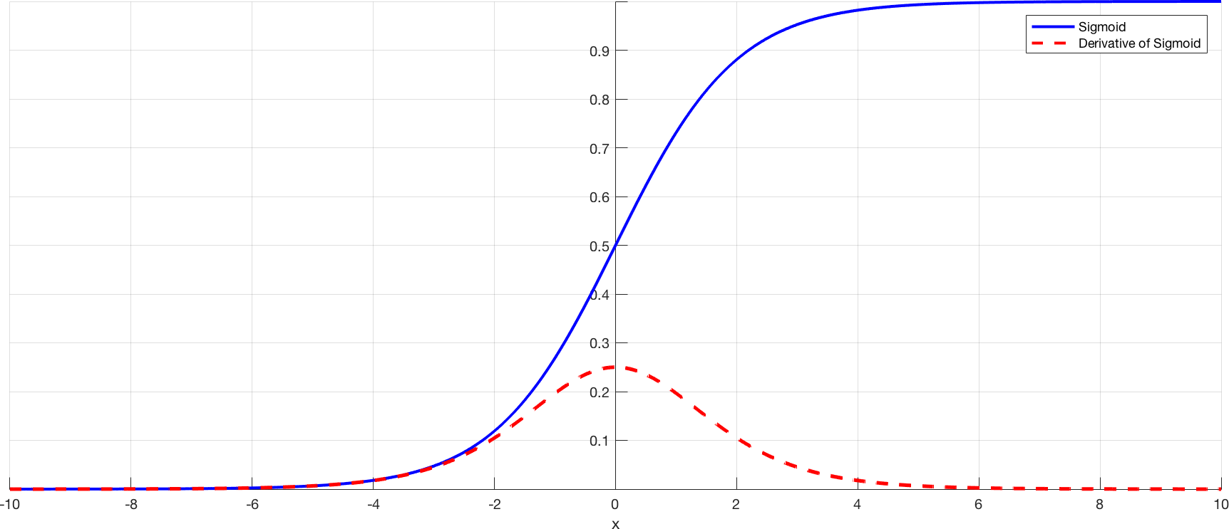
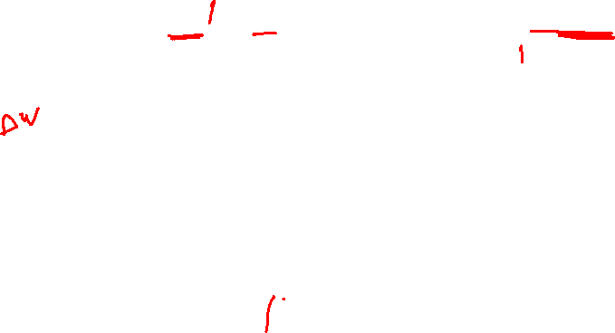
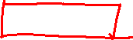
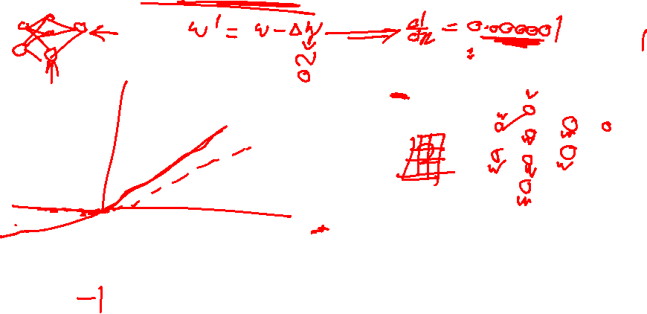
Problem of Vanishing Gradient

Slide 20
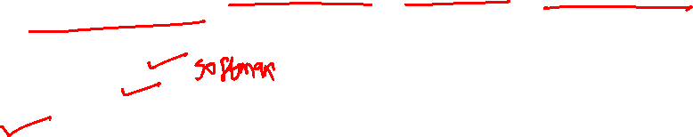
Poll 3
Which of following activation function can’t be used at output layer to
classify an image ?
sigmoid
Tanh
ReLU
D) If(x>5,1,0)
E) None of the above
Practice in teams of 4 students
Industry expert mentoring to learn better
Get personalised feedback for improvements
13-02-2021
Footer
11
25

Slide 21
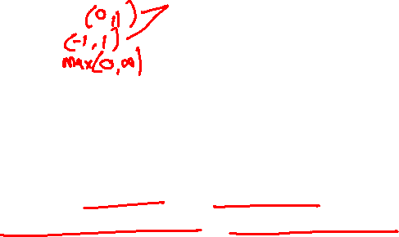
Poll 3
Which of following activation function can’t be used at output layer to
classify an image ?
sigmoid
Tanh
ReLU
D) If(x>5,1,0)
E) None of the above
Practice in teams of 4 students
Industry expert mentoring to learn better
Solution: C
ReLU gives continuous and infinite output, we
want a finite range of values. So option C is correct.
13-02-2021
Footer
11
26

Slide 22
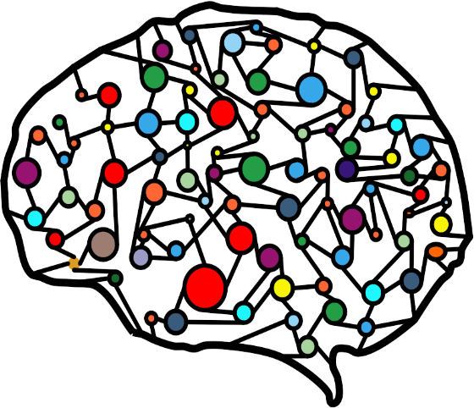

Multiple Neurons
The average human brain has 100 billion neurons
Allowing the brain to make extremely complicated
decisions
Each neuron is connected to 10,000 neurons
Which together create a complicated network of about 1000 trillion connections

Slide 23
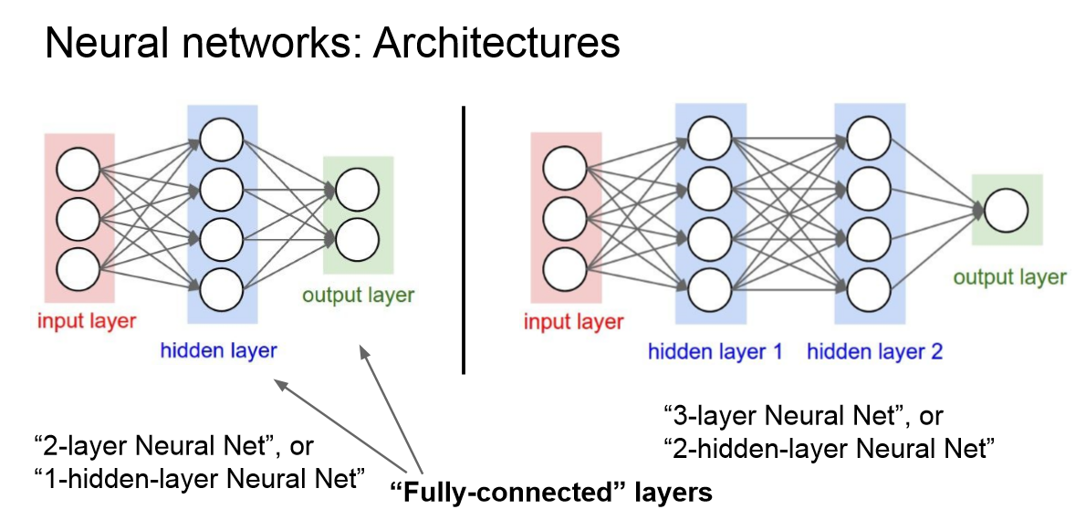
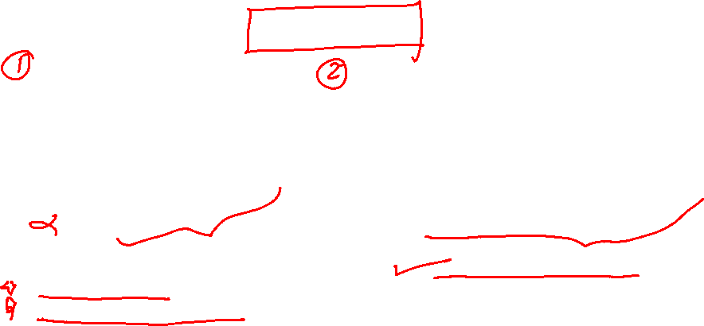

Slide 24
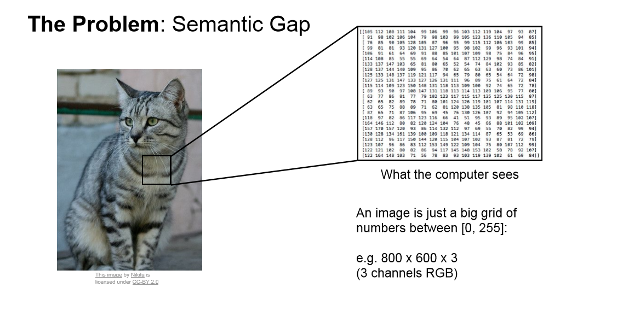
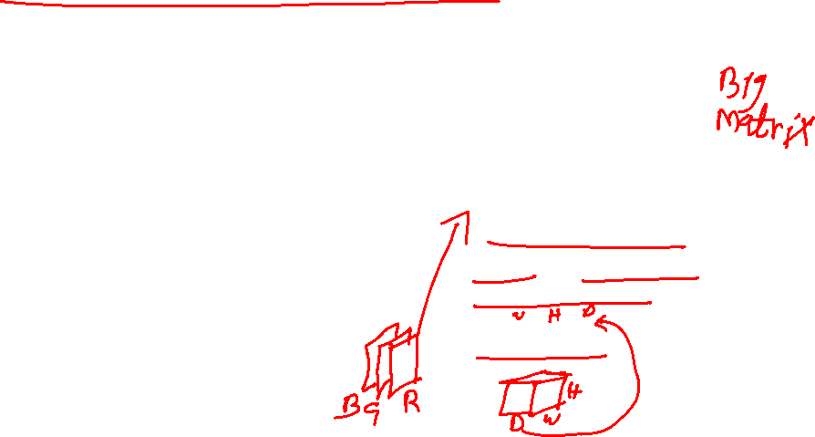
How computer interprets visual data

Slide 25
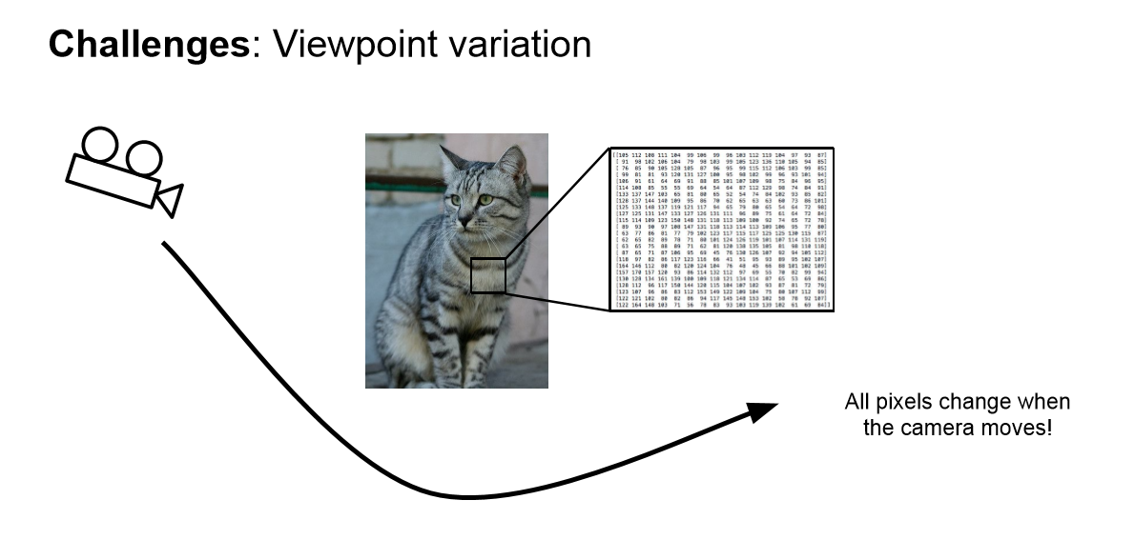
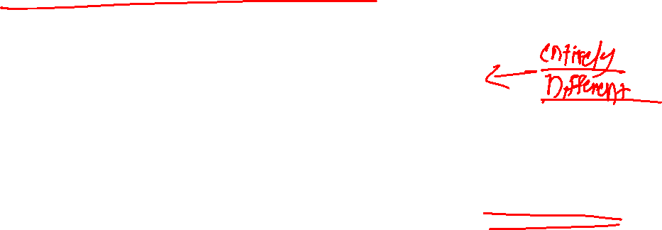

Slide 26
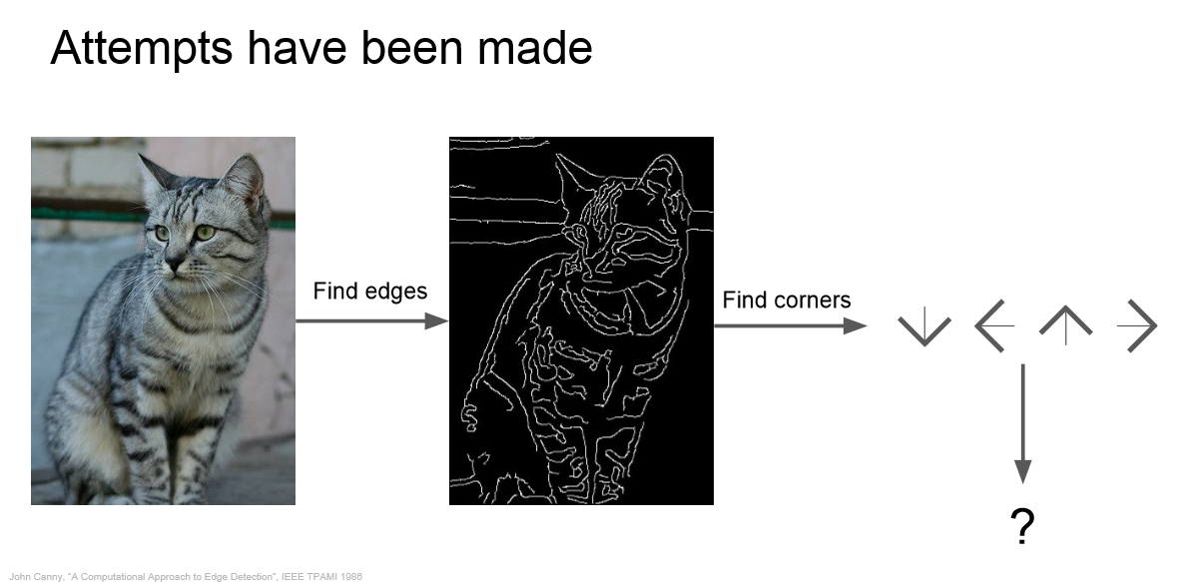
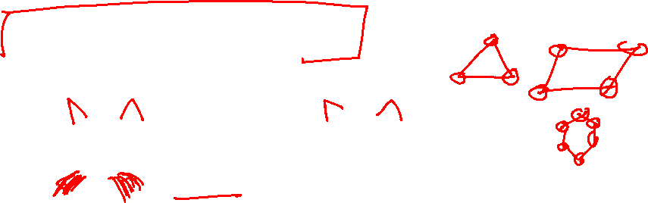

Slide 27
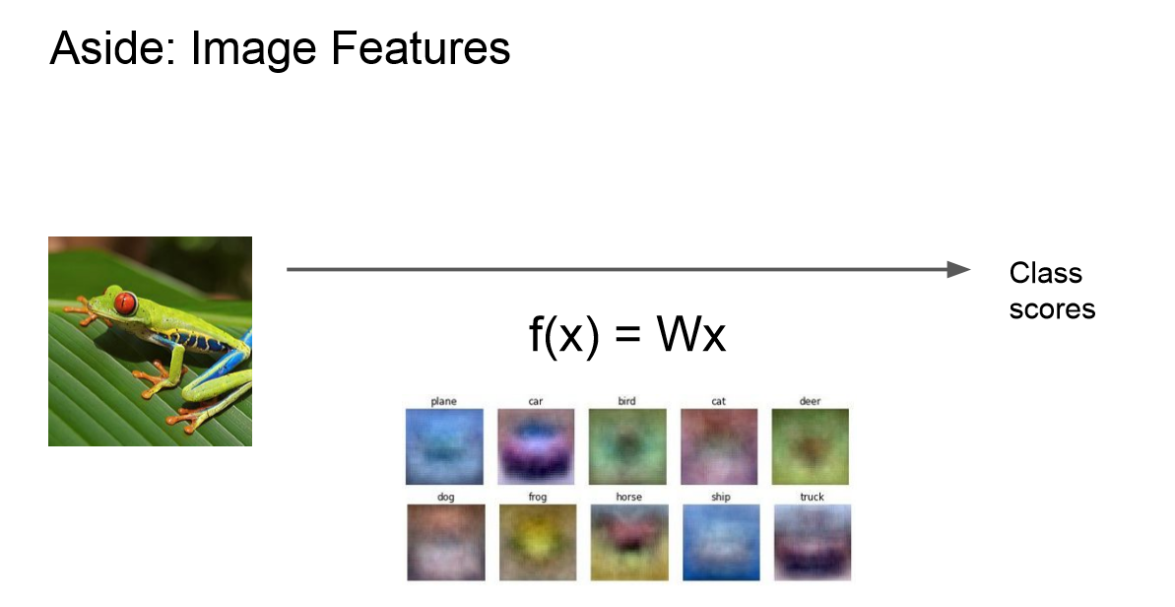

Slide 28
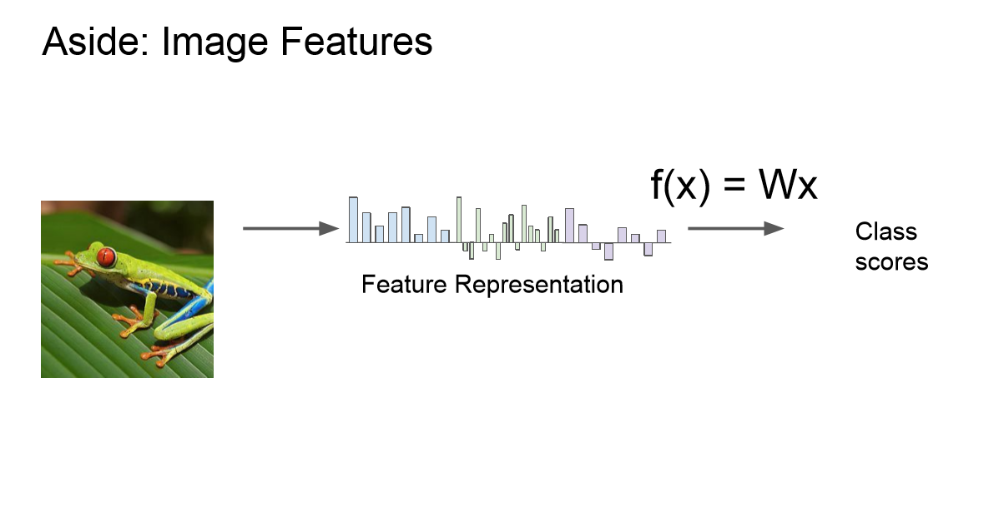

Slide 29
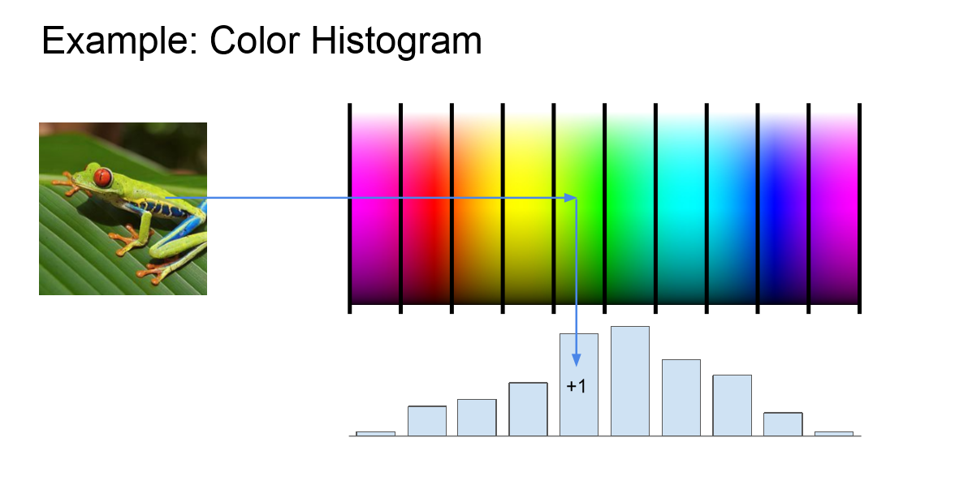

Slide 30
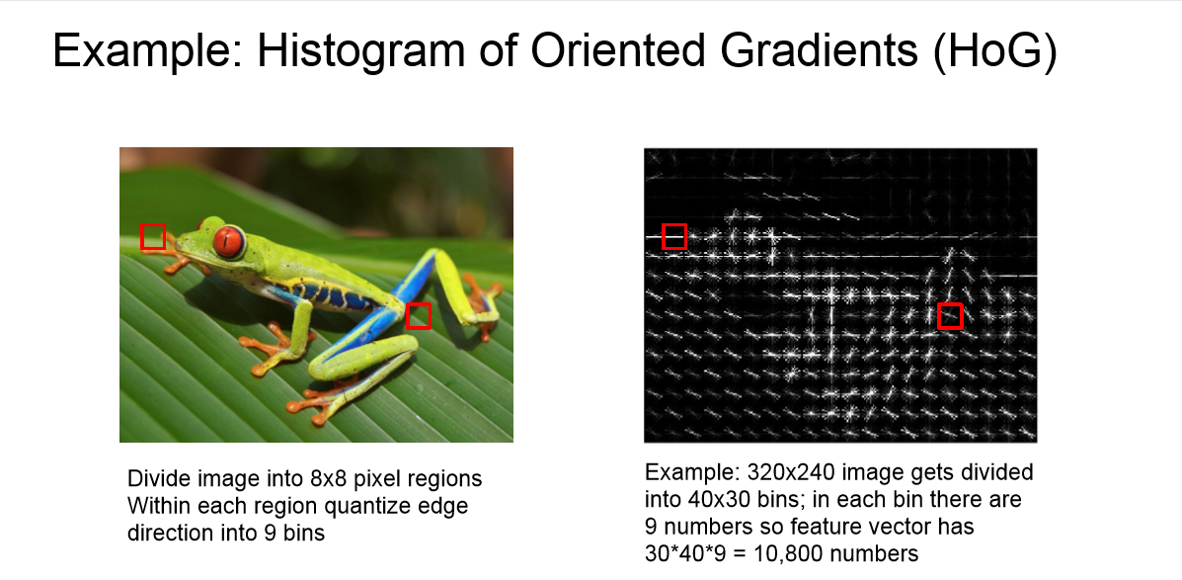


Slide 31


Slide 32



Slide 33





Feedforward
the output from one layer is used as input to the next layer. Such networks are called feedforward neural networks.

Slide 34


Example
To create a classifier we want the output to look like as set of probabilities
By feeding the input through the network we get a set of scores Y called “logits” but in here they cannot be used as probabilities
They are not within the range [0,1]
They do not add up to 1.

Slide 35



Example
To convert logits into probabilities we can use the softmax function
This guarantees all values are between [0,z] and they add up to 1.

Slide 36


Cost Function
A Cost Function/Loss Function evaluates the performance of our Machine Learning Algorithm. The Loss function computes the error for a single training example while the Cost function is the average of the loss functions for all the training examples.
The goal of any Learning Algorithm is to minimize the Cost Function.
lower error between the actual and the predicted values signifies that the algorithm has done a good job in learning.
A common measure of the discrepancy between the two values is the ”Cross-entropy”

Slide 37


Backward Propagation

Slide 38


Backward Propagation

Slide 39

Backward Propagation

Slide 40

Backward Propagation

Slide 41


Backward Propagation

Slide 42


Backward Propagation

Slide 43


Backward Propagation

Slide 44


Backward Propagation

Slide 45


Backward Propagation

Slide 46

Backward Propagation
We know that propagation is used to calculate the gradient of the loss function with respect to the parameters.

Slide 47


Computing Gradients
L – Last Layer
L-1 – Second Last Layer
l = Layer
W = Weight Connections from one neuron to another
a = Activations (all the neurons)
Y = Output value which we want to predict
b = Bias (added value to each activation) C = Cost Function / Loss Function
Z = W * a +- b

Slide 48

Summarization
https://mlfromscratch.com/

Slide 49


Backward Propagation
dZ — Gradient of the cost with respect to
the linear output (of current layer l).

Slide 50

Let’s dive into TensorFlow

Slide 51


What’s a tensor?
A tensor is a data container

Slide 52



Slide 53



Slide 54
Getting Started

Slide 55
import tensorflow as tf

Slide 56


Data Flow Graphs
import tensorflow as tf a = tf.add(3, 5)
Why x, y?
TF automatically names the nodes when you don’t explicitly name them.
x = 3
y = 5

Slide 57
Data Flow Graphs
import tensorflow as tf a = tf.add(3, 5)
3
a
5
>> Tensor("Add:0", shape=(), dtype=int32)
(Not 8)

Slide 58

Because we haven’t created a session!
A Session object encapsulates the environment in which Operation objects are executed, and Tensor objects are evaluated.
Session will also allocate memory to store the current values of variables.

Slide 59

Data Flow Graphs
import tensorflow as tf a = tf.add(3, 5)
with tf.Session() as sess: print(sess.run(a))
3
8
a
5
>> 8

Slide 60


We can select which operation to perform within tf.Session()
x = 2 y = 3 op1 = tf.add(x, y) op2 = tf.multiply(x, y) op3 = tf.pow(op2, op1) with tf.Session() as sess: op3 = sess.run(op3)

Slide 61


Subgraphs
Possible to break graphs into several chunks and run them parallelly across multiple CPUs, GPUs, TPUs, or other devices.
Example: AlexNet

Slide 62

Distributed Computation
To put part of a graph on a specific CPU or GPU:
# Creates a graph.
with tf.device('/gpu:2'):
a = tf.constant([1.0, 2.0, 3.0, 4.0, 5.0, 6.0], name='a')
b = tf.constant([1.0, 2.0, 3.0, 4.0, 5.0, 6.0], name='b')
c = tf.multiply(a, b)
# Creates a session with log_device_placement set to True.
sess = tf.Session(config=tf.ConfigProto(log_device_placement=True))
# Runs the op.
print(sess.run(c))

Slide 63
What if I want to build more than one graph?

Slide 64

Yeah, You can But you shouldn’t

Slide 65

Multiple graphs require multiple sessions, each will try to use all available resources by default
Can't pass data between them without passing them through python/numpy, which doesn't work in distributed
It’s better to have disconnected subgraphs within one graph
BUG ALERT!

Slide 66


Why Graphs (TensorFlow)
Save computation. Only run subgraphs that lead to the values you want to fetch.
Break computation into small, differential pieces to facilitate auto-differentiation
Facilitate distributed computation, spread the work across multiple CPUs, GPUs, TPUs, or other devices
Many common machine learning models are taught and visualized as directed graphs

Slide 67

1st Convolutional Neural Network

Slide 68

Convolution Layer
32x32x3 image
32
height
32
width
3
depth
Slide credit: CS231n Lecture 7

Slide 69

Convolution Layer
32x32x3 image
Filters always extend the full depth of the input volume
32
height
5x5x3 filter
Convolve the filter with the image
i.e. “slide over the image spatially, computing dot products”
32
width
3
depth
Slide credit: CS231n Lecture 7

Slide 70

Convolution Layer
activation maps
32x32x3 image
5x5x3 filter
32
28
convolve (slide) over all spatial locations
32
28
3
1

Slide 71



Slide 72

Convolution Layer
activation maps
32x32x3 image
5x5x3 filter
32
28
convolve (slide) over all spatial locations
32
28
3
consider a second, green filter
2

Slide 73

For example, if we had 6 5x5 filters, we’ll get 6 separate activation maps:
activation maps
32
28
Convolution Layer
32
28
3
6
We stack these up to get a new “image” of size 28x28x6!

Slide 74

ConvNet is a sequence of Convolution Layers, interspersed with activation functions
32
28
24
….
CONV,
ReLU
e.g. 6 5x5x3 filters
CONV,
ReLU
e.g. 10 5x5x6 filters
CONV,
ReLU
32
28
24
3
6
10

Slide 75



one filter =>
one activation map
example 5x5 filters
(32 total)
We call the layer convolutional because it is related to convolution of two signals:
element-wise multiplication and sum of a filter and the signal (image)
Figure copyright Andrej Karpathy.

Slide 76

A closer look at spatial dimensions:
7
7x7 input (spatially)
assume 3x3 filter
7

Slide 77
A closer look at spatial dimensions:
7
7x7 input (spatially)
assume 3x3 filter
7

Slide 78
A closer look at spatial dimensions:
7
7x7 input (spatially)
assume 3x3 filter
7

Slide 79

A closer look at spatial dimensions:
7
7x7 input (spatially)
assume 3x3 filter
7

Slide 80

A closer look at spatial dimensions:
7
=> 5x5 output
7x7 input (spatially)
assume 3x3 filter
7

Slide 81
A closer look at spatial dimensions:
7
7x7 input (spatially)
assume 3x3 filter
applied with stride 2
7

Slide 82
A closer look at spatial dimensions:
7
7x7 input (spatially)
assume 3x3 filter
applied with stride 2
7

Slide 83

A closer look at spatial dimensions:
7
7x7 input (spatially)
assume 3x3 filter
applied with stride 2
=> 3x3 output!
7

Slide 84

A closer look at spatial dimensions:
7
7x7 input (spatially)
assume 3x3 filter
applied with stride 3?
7

Slide 85

A closer look at spatial dimensions:
7
7x7 input (spatially)
assume 3x3 filter
applied with stride 3?
7
doesn’t fit!
cannot apply 3x3 filter on 7x7 input with stride 3.

Slide 86

N
Output size:
(N - F) / stride + 1
e.g. N = 7, F = 3:
stride 1 => (7 - 3)/1 + 1 = 5
stride 2 => (7 - 3)/2 + 1 = 3
stride 3 => (7 - 3)/3 + 1 = 2.33 :\
F
N
F

Slide 87


Slide 88

In practice: Common to zero pad the border
0 | 0 | 0 | 0 | 0 | 0
0
0
0
0
e.g. input 7x7
3x3 filter, applied with stride 1
pad with 1 pixel border => what is the output?
(recall:)
(N - F) / stride + 1

Slide 89
In practice: Common to zero pad the border
0 | 0 | 0 | 0 | 0 | 0
0
0
0
0
e.g. input 7x7
3x3 filter, applied with stride 1
pad with 1 pixel border => what is the output?
7x7 output!

Slide 90

In practice: Common to zero pad the border
0 | 0 | 0 | 0 | 0 | 0
0
0
0
0
e.g. input 7x7
3x3 filter, applied with stride 1
pad with 1 pixel border => what is the output?
7x7 output!
in general, common to see CONV layers with stride 1, filters of size FxF, and zero-padding with (F-1)/2. (will preserve size spatially)
e.g. F = 3 => zero pad with 1
F = 5 => zero pad with 2
F = 7 => zero pad with 3

Slide 91



Slide 92

Common settings:
K = (powers of 2, e.g. 32, 64, 128, 512)
F = 3, S = 1, P = 1
F = 5, S = 1, P = 2
F = 5, S = 2, P = ? (whatever fits)
F = 1, S = 1, P = 0

Slide 93


What is Dropout?

Slide 94



Slide 95


Pooling Layer
Makes the representation smaller and more manageable
Operates over each activation map independently

Slide 96

Max Pooling
Single depth slice
1 | 1 | 2 | 4
5 | 6 | 7 | 8
3 | 2 | 1 | 0
1 | 2 | 3 | 4
x
max pool with
2x2 filters and stride 2
6 | 8
3 | 4
y

Slide 97


Max Pooling
Common settings:
F = 2, S = 2
F = 3, S = 2

Slide 98
Regularization

Slide 99

Ridge (L2)
RSS is modified by adding the shrinkage quantity. Now, the coefficients are estimated by minimizing this function. Here, λ is the tuning parameter that decides how much we want to penalize the flexibility of our model. The increase in flexibility of a model is represented by increase in its coefficients, and if we want to minimize the above function, then these coefficients need to be small.

Slide 100

Lasso (L1)
Lasso is another variation, in which the above function is minimized. Its clear that this variation differs from ridge only in penalizing the high coefficients.

Slide 101

Regularization
The ridge regularization is expressed by β1² + β2² ≤ s. This implies that ridge regression coefficients have the smallest RSS(loss function) for all points that lie within the circle given by β1² + β2² ≤ s
The lasso, the equation becomes,|β1|+|β2|≤ s. This implies that lasso coefficients have the smallest RSS(loss function) for all points that lie within the diamond given by |β1|+|β2|≤ s.

Slide 102


Training
Training refers to the task of finding the optimal combination of weights and biases to minimize the total loss
The optimization is done using the familiar gradient descent algorithm. In gradient descent, the parameter being optimized is iterated in the direction of reducing cost according to the following rule

Slide 103


Gradient Descent
Starting at the top of the mountain, we take our first step downhill in the direction specified by the negative gradient. Next we recalculate the negative gradient (passing in the coordinates of our new point) and take another step in the direction it specifies. We continue this process iteratively until we get to the bottom of our graph, or to a point where we can no longer move downhill–a local minimum.
Gradient descent is an optimization algorithm used to minimize some function by iteratively moving in the direction of steepest descent as defined by the negative of the gradient

Slide 104


Gradient Descent
In practice, we might never exactly reach the minima, but we keep oscillating in a flat region in close vicinity of the minima. As we oscillate our this region, the loss is almost the minimum we can achieve, and doesn't change much as we just keep bouncing around the actual minimum.
Often, we stop our iterations when the loss values haven't improved in a pre-decided number, say, 10, or 20 iterations. When such a thing happens, we say our training has converged, or convergence has taken place.
22-05-2022

Slide 105

Example
GIF'ed from 3blue1brown video

Slide 106

Gradient Desent – Way to Find Weights
43

Slide 107



#LifeKoKaroLift
Thank You!
21
13-02-2021

